Slide 1
Two-view Depth Estimation
Algorithms:
SIFT
RANSAC - for randomly selecting the points and getting the best fit.
Box matching
Presented by :
Deepak Gupta - 2019158
Aditya Gupta - 2019138
Aurko mitra -

Slide 2
Problem Statement
In this project, we are going to implement Two-view Depth Estimation.
We will be taking two images of the same scenario but taken from two different camera angles.By comparing the information about a scene from 2 vantage points, we can obtain the 3D information by examining the relative positions of objects.

Slide 3
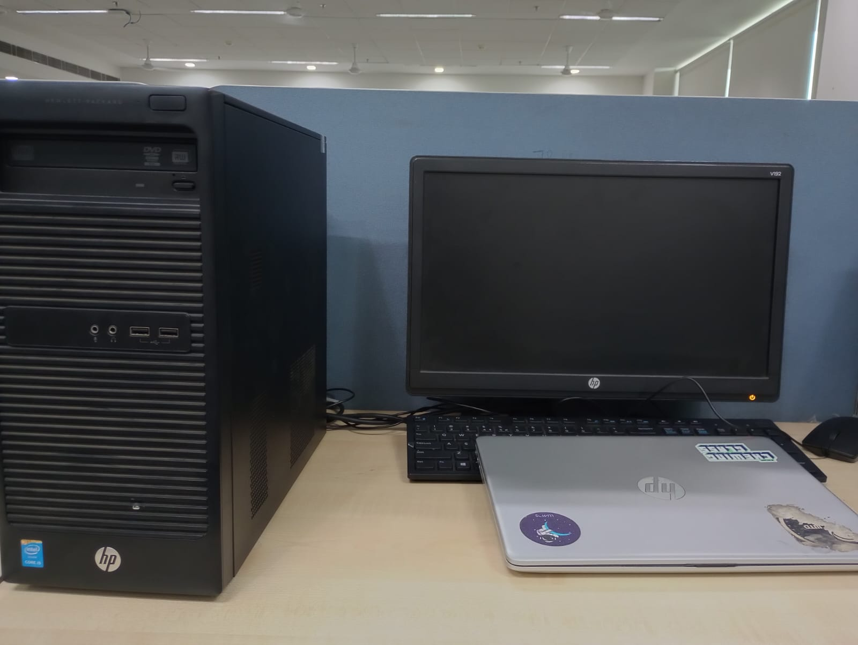
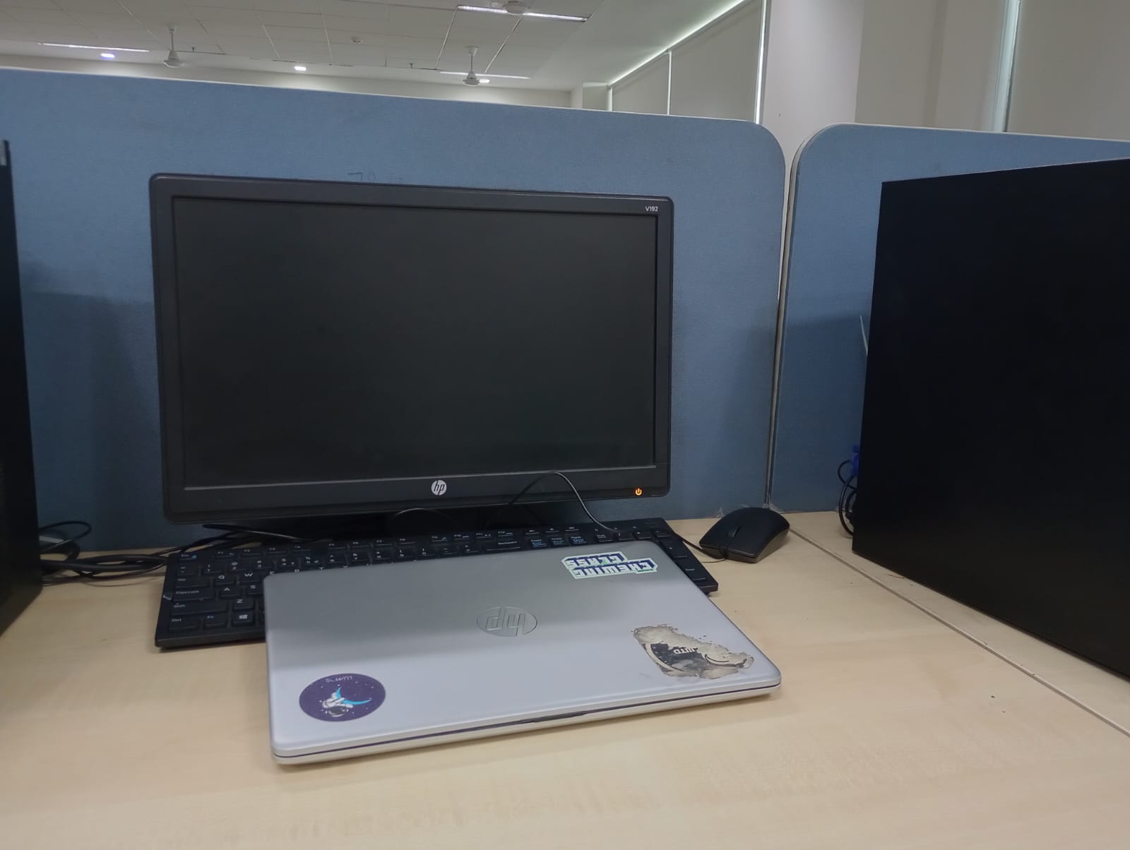
Dataset
We have used middleBury stereo dataset to check the calculation.
But also performed the calculation on our self clicked images.

Slide 4
Methodology
Calibration:
Feature Matching:
We will be reading the image from the dataset.
Obtaining features using SIFT.
Then detecting feature points.
Estimating the fundamental matrix
Fundamental matrix will provide us with a relationship between any two images of the same scene taken from either the same camera at different places.
We need to get 8 best point correspondence from the sorted matches to compute fundamental mtx.

Slide 5
Methodology
Calibration:
3.) Essential Matrix
The essential matrix is 3x3 matrix that encodes epipolar geometry.
E = (K2)’ F (K1)
4.) Recovering the camera pose
We will be calculating the rotation matrix and translation matrix to position the camera for
the two images correspondingly.
Rectification:
Rectification of an image means, making it collimate with its axis. So here we have done a transformation which makes the pair of conjugates epipolar lines formed in pages to become collinear and parallel to the horizontal axis which is called the baseline of the image.

Slide 6
Methodology
Correspondence
In this part we find the corresponding region in each of the images. For match features that we have obtained in the above parts of the problem.
For performing block matching, we choose a window size and slid it across the epipolar line along every matching pixel coordinate index. After doing this we could retrieve the matching correspondence on the epipolar line with the least SAD vlaue.
Depth calculation
After finding the disparity of the images, we can find the depth of the image using disparity information and information provided.
Depth = (focal length*baseline)/disparity

Slide 7
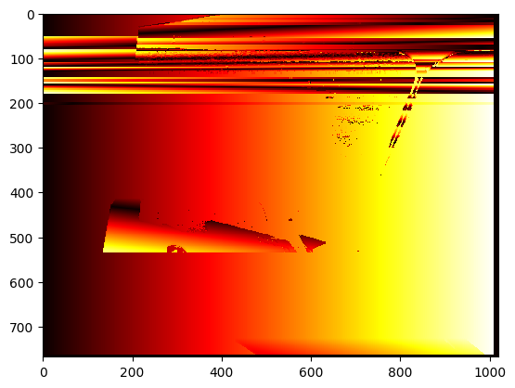
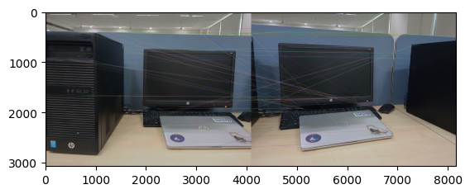
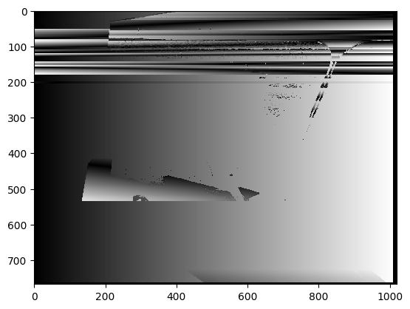
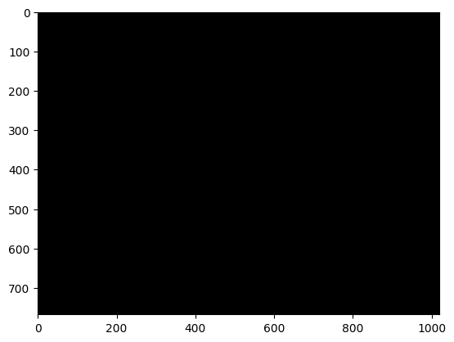
Result

Slide 8
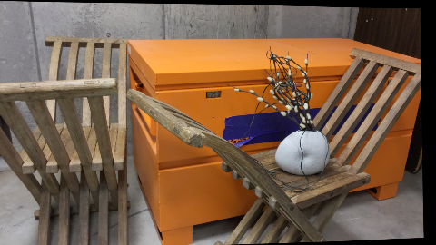
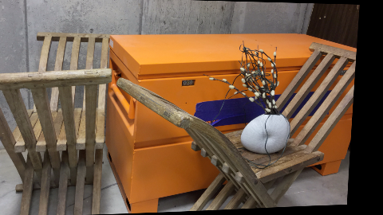
Result
Rectified Image

Slide 9
THANK YOU

